Slide 1
Git Training
Brian Pittman
brian.pittman.3.ctr@us.af.mil
12/7/2015

Slide 2
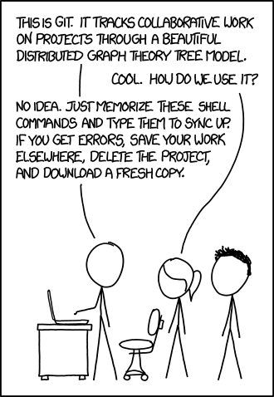
Obligatory XKCD

Slide 3
Building Blocks of Git
Blobs
Each file in the repo is represented by a blob
Trees
Each directory is represented by a tree
Trees can contain other trees (subdirectories) and blobs (files in the directory)
Commits
A snapshot of your working tree at a point in time, plus some metadata (author, commit date, parent commits, SHA1 hash, etc)
Refs
Bookmarks to a certain node in the repository

Slide 4
Building Blocks of Git: SHAs
A commit is uniquely identified by a 160-bit hex value (the 'SHA'). This is computed from the tree, plus the following pieces of information:
the SHA of the parent commit(s) -- every commit except the very first one in the repo has at least one parent commit that the change is based upon
the commit message
the author name/email/timestamp
the committer name/email/timestamp
The other git object types are referenced by SHAs as well, but these are generally not relevant
The SHA is a globally unique identifier across all git repos
Existing commits cannot be modified. Any time it seems like they are, a new commit is being created behind the scenes with a different SHA

Slide 5

Building Blocks of Git: repositories
A directed acyclic graph of commits
Normally represented visually with time moving upward (oldest commits at the bottom)

Slide 6
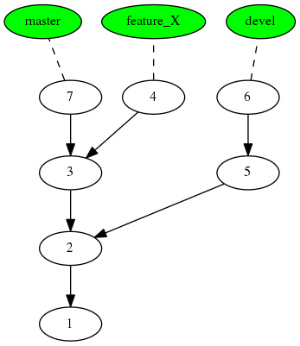
Building Blocks of Git: Branches
Branches are stored as a reference to the commit at the tip of the branch
The master branch is created by default

Slide 7
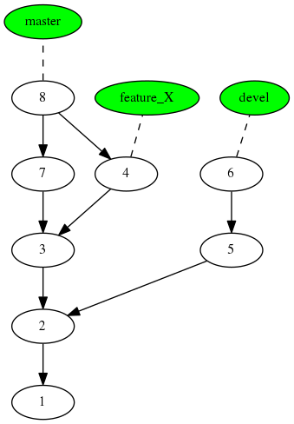
Building Blocks of Git: Merging
Commit 8 is a merge commit because it has 2 parents

Slide 8
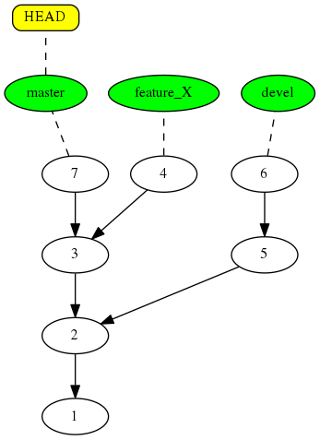
Building Blocks of Git: HEAD
HEAD is a special reference that points to the currently checked out branch

Slide 9
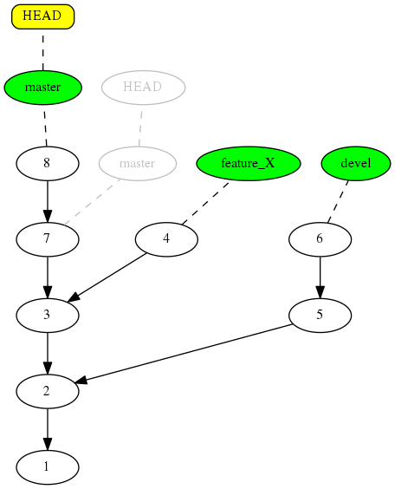
Building Blocks of Git: Committing
When you make a commit, the current branch ref moves

Slide 10
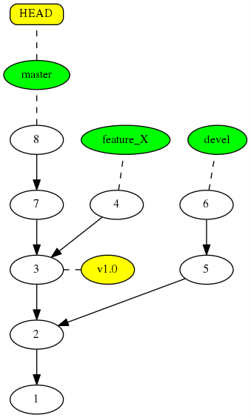
Building Blocks of Git: Tags
Tags are like branches, except they never move

Slide 11
Repository Setup: git init
git init
Transform the current directory into a Git repository. This adds a .git folder to the current directory and makes it possible to start recording revisions of the project.
git init --bare
Initialize an empty Git repository, but omit the working directory. Shared repositories should always be created with the --bare flag
Central repositories should always be created as bare repositories because pushing branches to a non-bare repository has the potential to overwrite changes. Think of --bare as a way to mark a repository as a storage facility, opposed to a development environment. This means that for virtually all Git workflows, the central repository is bare, and developers local repositories are non-bare.
git init --shared
Specify that the Git repository is to be shared amongst several users.

Slide 12
Repository Setup: git clone
git clone <repo>
Clone the repository located at <repo> onto the local machine. The original repository can be located on the local filesystem or on a remote machine accessible via HTTP or SSH.
Unlike SVN, Git makes no distinction between the working copy and the central repository—they are all full-fledged Git repositories.
Creates a remote called “origin” pointing to the location of <repo>

Slide 13
Workflow example: Make a repo from existing code
cd projectdir
git init
git add .
git commit -m “initial commit”

Slide 14
Repository Setup: git config
Always set these:
git config --global user.name <name>
git config --global user.email <email>
Usability settings:
git config --global alias.<alias-name> <git-command>
git config --global core.editor <editor>
git config --global color.ui always
For shared-access repositories:
git config receive.denyNonFastForwards true
“git help config” for an exhaustive list

Slide 15
Making Changes: git add
git add <file>
The git add command adds a change in the working directory to the staging area. It tells Git that you want to include updates to a particular file in the next commit.
NOT equivalent to svn add
git add -p
Begin an interactive staging session that lets you choose portions of a file to add to the next commit. This will present you with a chunk of changes and prompt you for a command. Use y to stage the chunk, n to ignore the chunk, s to split it into smaller chunks, e to manually edit the chunk, and q to exit.

Slide 16
Making Changes: Staging Area
Sometimes also called the cache, or index
git status
Shows which files are staged, unstaged, or untracked
git diff
Shows a diff between the previous commit and the unstaged changes in the working directory
git diff --cached
Shows a diff between the previous commit and the staged changes in the working directory

Slide 17
Making changes: git commit
git commit
Commit the staged snapshot. This will launch a text editor prompting you for a commit message. After you’ve entered a message, save the file and close the editor to create the actual commit.
git commit -m “commit message”
Commit the staged snapshot, but instead of launching a text editor, use <message> as the commit message.
git commit -a
Commit a snapshot of all changes in the working directory (including unstaged changes, but not untracked files.)

Slide 18
Making changes: git commit
Commits are local
Commits can be buffered in your local repository until you are ready to push them to the central repository.
Commit early/often, without fear of breaking the central repository
Commit messages: One line summary, detailed description on following lines

Slide 19
Example
Git add subset of files & commit
Git add subset of changes within a file and commit
Examine git status / git log before and after committing

Slide 20
Example Workflow
Work
Commit
Test
Fix
Commit
<Repeat 1-5 as needed>
Reintegrate other’s changes
Cleanup
Push

Slide 21
Inspecting the Repo: Git status
A summary of the current state of the repo
Current branch
Ahead/behind origin repository
Unstaged/staged changes and untracked files
Use .gitignore to keep untracked file list clean of build artifacts and other clutter

Slide 22
Inspecting the Repo: git log
git log
Display the entire commit history using the default formatting.
git log -n <limit>
Limit the number of commits by <limit>. For example, git log -n 3 will display only 3 commits. (git log -3 also works)
git log --stat
Also include which files were altered and the relative number of lines that were added or deleted from each of them.
git log -p
Shows the full diff of each commit
git log --author="<pattern>“
git log --oneline
git log --grep="<pattern>“
git log <since>..<until>
git log <file>
git log --graph --decorate --oneline

Slide 23
Inspecting the Repo: Identifying commits
Each commit is represented by a 40-character hexadecimal checksum of its contents.
You only have to specify a enough of the SHA1 to uniquely identify it: the first 5-6 characters are plenty
HEAD
The current commit
3157e~1 or 3157e^
The parent commit of 3157e
HEAD~3 or HEAD^^^
The great-grandparent of the current commit

Slide 24
Inspecting the Repo: git grep
git grep <pattern>
Search for the specified pattern in tracked files in the working copy.
Faster than standard UNIX grep because it only searches tracked files.

Slide 25
Moving Between Commits: git checkout
git checkout <branch>
Check out a different branch.
git checkout <commit> <file>
Check out a previous version of a file. This turns the <file> that resides in the working directory into an exact copy of the one from <commit> and adds it to the staging area.
git checkout <commit>
Update all files in the working directory to match the specified commit. You can use either a commit hash or a tag as the <commit> argument. This will put you in a detached HEAD state.

Slide 26
Tangent: Detached HEAD
During the normal course of development, the HEAD usually points to master or some other local branch
When you check out a commit or tag, HEAD no longer points to a branch—it points directly to a commit. This is called a “detached HEAD” state.
Further commits made from a detached HEAD state will not be saved, because they are not a part of any branch.

Slide 27
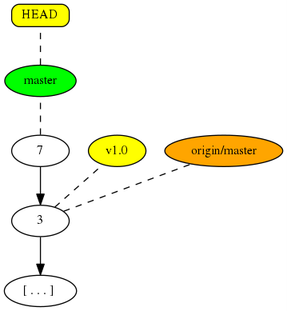
Tangent: Detached HEAD
Initial state
HEAD points to master branch

Slide 28
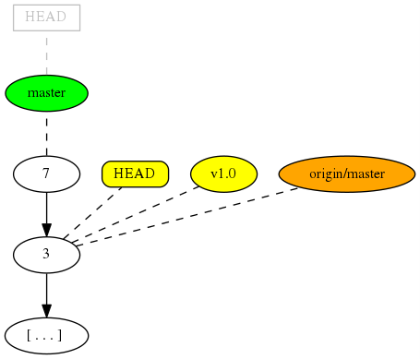
Tangent: Detached HEAD
Result of “git checkout v1.0”
Now in a detached HEAD state

Slide 29
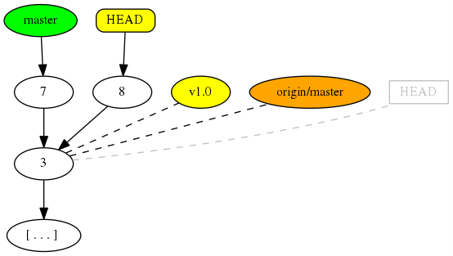
Tangent: Detached HEAD
Commit 8 is not on any branch

Slide 30
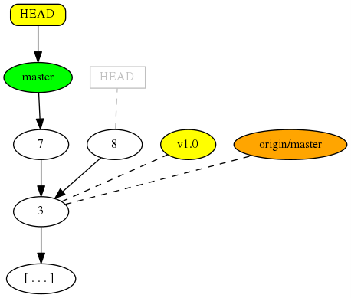
Tangent: Detached HEAD
Result of “git checkout master”
Now we have no (easy) way of reaching commit 8, and it is a candidate for garbage collection

Slide 31
Undoing changes
git checkout <commit> <file>
As previously discussed, this form of git checkout can undo changes to a particular file
git revert <commit>
Negates the changes introduced by <commit> by creating a new commit that reverses them.
This is a safe way to undo a commit that is already a part of shared history, because the original commit is untouched.
NOT like svn revert

Slide 32
Undoing changes
git reset <file>
Remove the specified file from the staging area, but leave the working directory unchanged. This unstages a file without overwriting any changes.
git reset <commit>
Move the current branch tip backward to <commit>, reset the staging area to match, but leave the working directory alone. All changes made since <commit> will reside in the working directory. This can modify shared history!

Slide 33
Undoing changes
git reset --hard
In addition to unstaging changes, the --hard flag tells Git to overwrite all changes in the working directory, too. USE WITH CAUTION.
git reset --hard <commit>
Move the current branch tip backward to <commit> and reset both the staging area and the working directory to match. This obliterates not only the uncommitted changes, but all commits after <commit>, as well. USE WITH CAUTION.
Use git revert to undo public changes, and git reset to undo private changes.

Slide 34
Undoing changes
git clean: Removes untracked files from repository. USE WITH CAUTION. Useful for quickly deleting build products
git clean -n
Dry run: don’t actually delete anything
git clean -f
Remove untracked files from the current directory. This will not remove untracked folders or files specified by .gitignore.
git clean -df
Remove untracked files and untracked directories from the current directory.
git clean -xf
Remove untracked files from the current directory as well as any files that Git usually ignores.

Slide 35
Example
Git checkout
Git revert
Git reset
Git clean

Slide 36
Rewriting History
git commit --amend
Combine staged changes with the previous commit instead of making a new commit. Can also be used to simply edit the previous commit message.
Don’t use on commits that are part of public history

Slide 37
Rewriting History: rebase
git rebase <base>
Effectively, move a branch to a new <base> commit, branch, tag, etc.
This is accomplished by creating new copies of the commits on the new base. The SHA1’s will change!
Useful for maintaining a linear history.
Not to be used on public history.

Slide 38
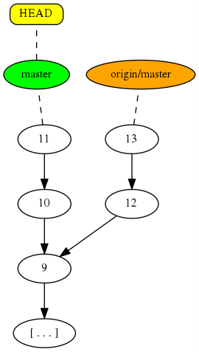
Rewriting History: rebase
Initial state: origin/master has two commits that are not on our local master

Slide 39
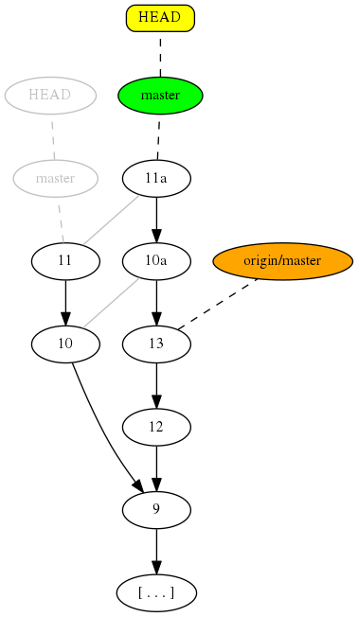
Rewriting History: rebase
Result of “git rebase origin/master”
The changes from commits 10 & 11 have been copied to new commits 10a & 11a based on origin/master
Master now points to 11a
We now have a linear history that can be easily pushed back to origin

Slide 40
Rewriting History
git rebase -i <base>
Interactively rebase commits, with the opportunity to remove, split, combine, or otherwise alter the commits in the process.
Most powerful way to clean up a messy commit history before publishing.
Not to be used on public history.

Slide 41
Rewriting History
git cherry-pick <commit>
“Copy” <commit> as a new commit on top of the current HEAD.
Useful for grabbing a bugfix commit from a different branch when you don’t want to merge the entire branch.

Slide 42
Example
Git commit --amend
Git rebase
Git rebase -i
Git cherry-pick

Slide 43
Collaborating
git remote
List remote repositories
git remote -v
Include URLs
git remote add <name> <url>
Add a new remote. In the future, you can use <name> as a shortcut for <url> in other git commands.
git remote rm <name>
Remove a remote

Slide 44
Collaborating
git fetch <remote>
Fetch all of the branches from the remote repository, downloading all commits/files from the other repository.
git fetch <remote> <branch>
Same as above, but only fetch the specified branch.
This is a safe way to review others commits before merging their work with your own.

Slide 45
Collaborating: remote branches
Can be checked out just like local branches, but puts you in a detached HEAD state.
Effectively read-only branches.
git branch -r
List remote branches

Slide 46
Collaborating: Example workflow
git fetch origin
git log --oneline master..origin/master
git checkout master
git merge origin/master

Slide 47
Collaborating: git pull
git pull <remote>
Fetch the specified remote’s copy of the current branch and immediately merge it into the local copy.
Same as git fetch <remote> followed by git merge <remote>/<currentbranch>
git pull --rebase <remote>
Same as above, but use git rebase instead of git merge.
Makes for a cleaner, linear history, but should not be used if you have already published your history to a different remote.

Slide 48
Example
Git fetch + git merge
Git pull
Git pull --rebase

Slide 49
Collaborating: git push
git push <remote> <branch>
Push the specified <branch> to <remote>, along with all the necessary commits and internal objects.
The push will fail if it results in a non-fast-forward merge in the destination repository.
git push <remote> <branch> --force
Force the push even if it results in a non-fast-forward merge. Don’t ever use this unless you are absolutely sure you know what you’re doing.
If receive.denyNonFastForwards is set on <remote> the push will fail even with –force.
git push <remote> --tags
Send all your local tags to the remote repository.
Only push to bare repositories.

Slide 50
Branching and Merging
Git branches are much more lightweight than svn, essentially just a reference to a commit, that represents the tip of the branch.
Using best practices will save lots of heartache when merging
Branches should be as short-lived as possible to minimize deviation from master
Longstanding branches should periodically merge master changes back into the branch
Communicate changes with the rest of dev team
Clean commit histories with 1 logical change per commit
Have a comprehensive test suite

Slide 51
Branching and Merging
git branch
List all of the branches in your repository
git branch <branch>
Create a new branch called <branch>. The new branch is NOT checked out.
git branch -d <branch>
Delete a branch. Will fail if the branch has unmerged changes.
git branch -D <branch>
Delete a branch, even if it has unmerged changes.
git branch -m <branch>
Rename the current branch to <branch>.

Slide 52
Branching and Merging
git checkout <branch>
Check out the (pre-existing) specified branch, and update the working directory to match.
git checkout –b <branch>
Create a new branch called <branch>, and check it out.
Can be used to return from a detached HEAD state.
Unstaged changes will persist to the new branch, unless they would cause a conflict, in which case the checkout fails.

Slide 53
Branching and Merging
git merge <branch>
Merge the specified branch into the current branch. Git will determine the merge method automatically.
git merge --no-ff <branch>
Always generate a merge commit, even if the merge was a fast-forward.
Useful if you want every merge to be documented with its own commit.
Never start a merge with uncommitted changes in your working tree, as this can make it more difficult to resolve conflicts or abort an unsuccessful merge
Fast-forward merges occur when there is a linear path from the current branch tip to the target branch. In this case, all git has to do is move the current branch tip up to the target branch tip.
Non-fast-forward merges occur if the branches have diverged.
A dedicated commit with two parents is used to tie together the two histories.

Slide 54
Branching and Merging
Generally, fast-forward merges are used for small features or bugfixes, and 3-way merges are used for the integration of longer-running features.
git merge --squash <branch>
Take all the commits from <branch> and squash them into one commit on the current branch.
Useful for integrating a large branch back into master without complicating history. Don’t use this unless the branch is to be deleted after the merge.

Slide 55
Branching and Merging: Strategies
3-way merge
Advantages
Merge history is explicitly shown in repository, and can be used by git to avoid re-resolving conflicts if the branches are merged again later
Can safely be performed if the affected branches are already published elsewhere
Disadvantages
Can make the repository history cluttered and difficult to follow

Slide 56
Branching and Merging: Strategies
Rebasing
Advantages
Commit history remains linear and easy to read
Disadvantages
Modifies history, cannot be used if changes have been published elsewhere
No way to tell that the commits originally came from the merged branch

Slide 57
Branching and Merging: Strategies
merge --squash
Advantages
Commit history remains linear and easy to read
Disadvantages
Entire commit history of branch is squashed into one monolithic commit, so granularity of original commits is lost

Slide 58
Example
Git merge
Git rebase
Git merge --squash

Slide 59
Branching and Merging: Conflicts
Git automatically stages all successful merge results, so “git diff” will show you what is left to resolve
Resolving merge conflicts uses the same edit/stage/commit workflow as the rest of git
Workflow:
git status/git diff to see conflicted files
Edit conflicted files
git add each file once conflicts are resolved
git commit
git merge --abort can be used if you wish to abandon an in-progress merge

Slide 60
Branching and Merging: Conflicts
Git diff uses the “combined diff” format when displaying merge conflicts
Two columns of data precede each line
1st column shows if the line is different between “our” branch (the active branch) and the working tree
2nd column shows if the line is different between “their” branch (the branch being merged) and the working tree
git show <mergecommit>
See the combined diff output for a completed merge commit, to see how it was resolved after the fact

Slide 61
Branching and Merging: Conflicts
git merge -Xignore-all-space
Ignore whitespace completely when comparing lines
git merge -Xignore-space-change
Treat sequences of one or more whitespace characters as equivalent when merging
git merge -Xours
In the case of conflicts, always choose “our” side
git merge –Xtheirs
In the case of conflicts, always choose “their” side

Slide 62
Branching and Merging: Conflicts
git show :1:<filename>
Show the common ancestor contents of <filename>
git show :2:<filename>
Show “our” version of <filename>, aka the version on the checked-out branch
git show :3:<filename>
Show “their” version of <filename>, aka the version on the branch being merged in

Slide 63
Branching and Merging: Conflicts
git diff --ours
Compare the working tree to what was in the current branch before the merge, aka see what changes the merge introduced
git diff --theirs
Compare the working tree to what was in the other branch before the merge
git diff --base
See how the working tree has changed from the base commit
git checkout --ours <filename>
Quick way to choose our side of the merge for <filename>
Particularly useful when merging binary files
git checkout --theirs <filename>
Opposite of above
git log --left-right --merge
List commits that touch files having a conflict that don’t exist on both HEAD and MERGE_HEAD
Useful to identify the commits that originally caused a conflict

Slide 64
Branching and Merging: Conflicts
git checkout --conflict=merge <filename>
Re-checkout <filename>, with the conflict markers
Useful if you don’t like how the merge was going and want to start over for <filename>
git checkout --conflict=diff3 <filename>
Same as above, but use the diff3 format instead
Diff3 format shows the contents of the base commit of the merge, in addition to ours and their side
git config --global merge.conflictstyle diff3
Make diff3 the default conflict resolution style

Slide 65
Example
Conflict resolution

Slide 66
Branching and Merging
How to delete an unwanted merge commit?
git reset --hard <commit>
Reset the branch to a <commit> before the merge commit
Can’t be used on shared history
git revert -m 1 <merge_commit>
Create a new commit that reverts <merge_commit>
-m argument tells revert which parent of the merge commit should be kept. 1 is the mainline commit, and 2 is the branch being merged.
If you ever want to re-merge the branch again, you’ll need to revert the revert commit first

Slide 67
Tagging
git tag
List tags
git tag -l “v1.8.5*”
List all tags that start with “v1.8.5”
git tag <tagname>
Create a new lightweight tag pointing to the current commit.
Lightweight tags are like branches that never change.
git tag -a <tagname>
Create an annotated tag pointing to the current commit.
Annotated tags are checksummed; contain the tagger name, email, and date; have a tagging message; and can be signed and verified with GNU Privacy Guard (GPG)
git tag -d <tagname>
Delete an existing tag. Don’t delete tags that are part of public history.
git push origin <tagname>
Push a single tag to origin.
git push origin --tags
Push all tags to origin.

Slide 68
Stashing
git stash
Move all unstaged and staged changes to tracked files onto a stack of changes that you can reapply at any time
git stash save <message>
Same as above, but also give the stash a descriptive message
git stash list
List all stashed changes
git stash apply
Apply the changes from the top stash on the stack to the working tree
Git stash apply <stash>
Apply the changes from <stash> to the working tree
git stash pop
Reapply the top stash from the stack to the working tree and remove it from the stack

Slide 69
Example
git stash

Slide 70
Archive
git archive --format=tar --prefix=v1.0release/ v1.0 -o v1.0release.tar
Quickly generate a pristine copy of any point in the repository history
No need to checkout first
Particularly useful for generating a copy of a tagged point in history

Slide 71
Reflog
Every time HEAD is updated a new entry is added to the reflog
git reflog
Display the reflog
git reset --hard HEAD@{3}
Reset the repository to the state of the 3rd entry in the reflog
This is git’s ultimate undo button
Particularly useful for retrieving commits made on a detached HEAD, as their SHAs will still be listed in the reflog
Note that the reflog cannot help you recover changes that were never included in any commit.

Slide 72
Example
Reflog usage

Slide 73
Bisect
Performs a binary search over a range of commits to find exactly when a bug was introduced
git bisect start
git bisect bad <commit>
git bisect good <commit>
git bisect reset
Use this when finished to put your working tree back the way it was

Slide 74
Backups
Local commits are great, but until you “git push” they exist only in your local repo
If you have many local commits or branches that you don’t want to push back to the central repo, make sure they are backed up somewhere

Slide 75
Other resources
git help <subcommand>
Show the git help for any git <subcommand>
http://eagain.net/articles/git-for-computer-scientists/
If you really want to dive deep into the internals
https://git-scm.com/book/en/v2
Exhaustive guide to using git

